Slide 1

Eagle Stream Code Architecture Introduction
Insyde Software April 2021

Slide 2
Copyright 2021 Insyde Software Corp., All Rights Reserved.
No part of this publication may be reproduced, transmitted, transcribed, stored in a retrieval system, or translated into any language or computer language, in any form, or by any means, electronic, mechanical, magnetic, optical, chemical, manual or otherwise, without the prior written permission of Insyde Software Corp.
Disclaimer
Insyde Software Corp. (“Insyde”), provides this document and the programs "as is" without warranty of any kind, either expressed or implied, including, but not limited to, the implied warranties of merchantability or fitness for a particular purpose.
This document may contain technical inaccuracies or typographical errors. Changes are periodically made to the information herein; these changes will be incorporated in future revisions of this document. Insyde is under no obligation to notify any person of the changes. Some code names featured in this document are used to identify products that are in development and not yet publicly announced for release. Insyde is not obligated for its accuracy or completeness.
This document may contain third party’s information, features, schedules, code names, and product names, which are based on Insyde’s interpretation available as of the creation of this document and may be changed from time to time. Neither Insyde nor the third party is obligated to notify such change. If you are interested in third party’s information, you may contact the local third party sales office or the local distributor to obtain the latest specifications. All the intellectual property right of any third party information remains to its owner or steward.

Slide 3
Agenda
Goals & Target Audience
Introduce New Codebase Directory Structure (Insyde Kernel)
Eagle Stream Code Architecture
Introduce Multiple Workspaces
Override Mechanism
FSP
Compile
Internal Use

Slide 4
Goal & Target Audience

Slide 5
Goal & Target Audience
Target Audience:
BIOS developers who use Eagle Stream to create their firmware products.
Goals:
Be familiar with Eagle Stream code structure.
Requirements:
Eagle Stream source code
05.4x.yy.zzzz

Slide 6
Introduce New Codebase Directory Structure (Insyde Kernel)

Slide 7
Introduce New Codebase Directory Structure (1/3)
Support GIT source code control
GIT does NOT support to get code from 2 GIT repositories into 1 folder
A directory named .git that contains all of necessary repository files for 1 GIT repository

Slide 8
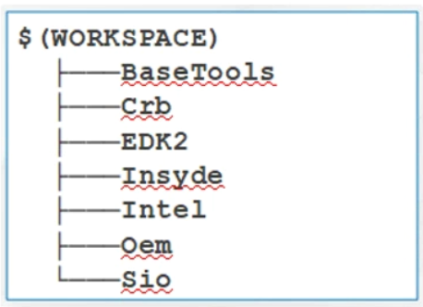
Introduce New Codebase Directory Structure (2/3)
New codebase directory structure prepare for coming GIT support
What does new codebase directory structure look like ?
BaseTools : Build tool directory
EDK2 : All EDK2 packages
Insyde : Most InsydeXXX packages (Kernel code)
Sio : SIO packages
Intel(Amd)\chipset-name : Silicon related packages
Oem : Feature and OEM feature packages
Oem\feature-name : Feature packages
Oem\oem-name : OEM packages
Crb : Project board package
Crb\Intel\chipset-crb-board
Crb\Oem\feature-crb-board
Crb\Oem\oem-crb-board
New Codebase Directory Structure

Slide 9
Introduce New Codebase Directory Structure (3/3)
Optional packages are located under corresponding Feature directory
EDK2\Feature
Insyde\Feature
Intel\chipset-name\Feature
Oem\feature-name\Feature
Oem\oem-name\Feature
Example : Console redirection package
Insyde\Feature\InsydeCrPkg from InsydeCrPkg GIT repository

Slide 10
Eagle Stream Code Structure

Slide 11
InsydeH2O 5.x Code Structure Terminology
Reference Code Package – Vendor-maintained chipset support code.
Insyde Chipset Package – Insyde-maintained chipset support code.
Project Package – Insyde or OEM-maintained board support code.
Kernel Package – Insyde-maintained industry-standard or Insyde-standard support code.

Slide 12
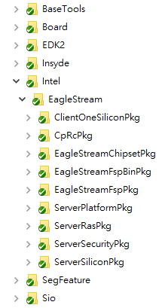
InydeH2O 5.4 Code Structure Folder Introduction
From Intel
BaseTools: Base tool related binaries
Board: CRB or Project board package
EDK2: EDK2 modules
Insyde: Insyde kernel modules
Intel: Chipset related modules
SegFeature: SEG feature Packages
Sio: SIO related modules
Chipset
Project
Insyde H2O Kernel

Slide 13
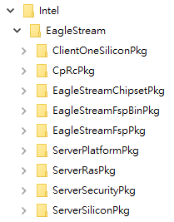
InydeH2O 5.4 Code Structure Insyde Source Code Structure – Eagle Stream
ClientOenSiliconPkg: Eagle Stream usage limited to TraceHub, PCH PCIe Library at present
CpRcPkg: USRA, interface for silicon register accessing
CCMRC
EagleStreamChipsetPkg: Insyde Chipset support code
EagleStreamFspBinPkg: FSP related header files and binaries that are auto-generated during building.
EagleStreamFspPkg: Glue code to build Eagle Stream FSP Binary
ServerPlatformPkg: Sever common features
ServerRasPkg: Server RAS implementation (exclude some Memory RAS features)
ServerSecurityPkg: Server security implementation
ServerSiliconPkg: Silicon package

Slide 14
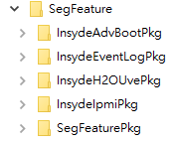
InydeH2O 5.4 Code Structure Insyde Source Code Structure – SegFeature
InsydeAdvBootPkg: Codes for advanced boot options
InsydeEventLogPkg: Codes to handle BIOS logs
InsydeH2OUvePkg: Codes to support H2OUVE tool
InsydeIpmiPkg: IPMI modules & libraries
SegFeaturePkg: Assist other SEG feature packages

Slide 15
Introduce Multiple Workspaces

Slide 16
Introduce Multiple Workspaces (1/6)
EDK2 build tools allows to set multiple paths that will be searched when attempting to resolve the location of packages
The new functionality is enabled through the addition of a new environment variable PACKAGES_PATH
PACKAGES_PATH environment variable is an ordered list of additional search paths
The first path in the list has the highest priority and the last path has the lowest priority
Paths using the default path separator of the host OS between each entry
‘;’ for Windows build environment and ‘:’ for Linux build environment
The path specified by the WORKSPACE environment variable always has the highest search priority over any PACKAGE_PATH entries

Slide 17
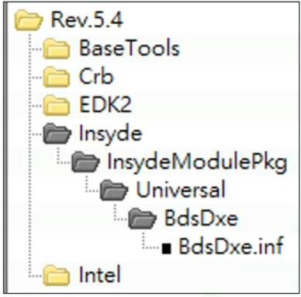
Introduce Multiple Workspaces (2/6)
PACKAGES_PATH is used for build tool to resolve the location of packages
Example 1: WORKSPACE=D:\Rev.5.4 PACKAGES_PATH=%WORKSPACE%\Insyde; %WORKSPACE%\EDK2
Q: In DSC or FDF file, “InsydeModulePkg/Universal/BdsDxe/BdsDxe.inf”. How build tool resolve the location ?
A: Build tools bases on following priority to find the file
D:\Rev.5.4\InsydeModulePkg\Universal\BdsDxe\BdsDxe.inf --------------------[Not Found]
D:\Rev.5.4\Insyde\InsydeModulePkg\Universal\BdsDxe\BdsDxe.inf ------------[Found]
D:\Rev.5.4\EDK2\InsydeModulePkg\Universal\BdsDxe\BdsDxe.inf

Slide 18
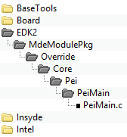
Introduce Multiple Workspaces (3/6)
Example 2: WORKSPACE=D:\Rev.5.4 PACKAGES_PATH=%WORKSPACE%\Insyde; %WORKSPACE%\EDK2
Q: MdeModulePkg/Core/Pei/PeiMain.inf { <SOURCE_OVERRIDE_PATH> MdeModulePkg/Override/Core/Pei } How build tool resolve the location ?
A: Build tools bases on following priority to find the file.
D:\Rev.5.4\MdeModulePkg\Override\Core\Pei\PeiMain.c -------------------[Not Found]
D:\Rev.5.4\Insyde\MdeModulePkg\Override\Core\Pei\PeiMain.c -----------[Not Found]
D:\Rev.5.4\EDK2\MdeModulePkg\Override\Core\Pei\PeiMain.c ------------[Found]
D:\Rev.5.4\MdeModulePkg\Core\Pei\PeiMain.c
D:\Rev.5.4\Insyde\MdeModulePkg\Core\Pei\PeiMain.c
D:\Rev.5.4\EDK2\MdeModulePkg\Core\Pei\PeiMain.c

Slide 19
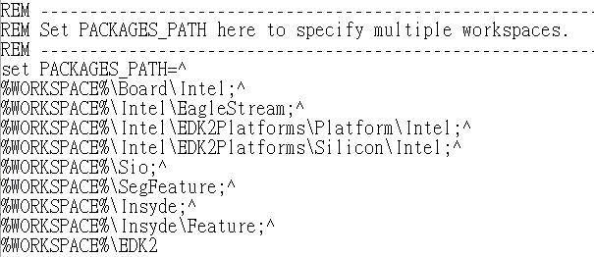
Introduce Multiple Workspaces (4/6)
Set the PACKAGES_PATH environment variable in ProjectSetup.bat

Slide 20
Introduce Multiple Workspaces (5/6)
PROJECT_REL_PATH environment variable (Insyde specific)
The directory, relative to WORKSPACE, of the directory that contains Project package
Example : “D:\Rev.5.4\Board\Intel\EagleStreamMultiBoardPkg”
WORKSPACE=D:\Rev.5.4
PROJECT_PKG=EagleStreamMultiBoardPkg
PROJECT_REL_PATH=Board\Intel
CHIPSET_REL_PATH environment variable (Insyde specific)
The directory, relative to WORKSPACE, of the directory that contains chipset package
Example : "D:\Rev.5.4\Intel\EagleStream\EagleStreamChipsetPkg "
WORKSPACE=D:\Rev.5.4
CHIPSET_PKG=EagleStreamChipsetPkg
CHIPSET_REL_PATH=Intel\EagleStream
PROJECT_REL_PATH and CHIPSET_REL_PATH are used to correct the file path relative to the WORKSPACE for new directory structure in .bat, …, .cmd files

Slide 21
Introduce Multiple Workspaces (6/6)
Make codebase support multiple workspaces
PACKAGES_PATH used to correct build tool which attempts to resolve the location of packages
PROJECT_REL_PATH and CHIPSET_REL_PATH used to correct the file path which relative to the WORKSPACE in .bat, …, .cmd files.
PACKAGES_PATH, PROJECT_REL_PATH and CHIPSET_REL_PATH environment variables are set after setting WORKSPACE in ProjectSetup.bat
PROJECT_REL_PATH and CHIPSET_REL_PATH value are obtained by GetProjectEnv.exe

Slide 22
Override Mechanism

Slide 23
How to Use Override Override in Project.dsc
Syntax
Example
!disable Original_Path/Module.inf
!disable MdeModulePkg/Universal/StatusCodeHandler/Smm/StatusCodeHandlerSmm.inf
Original_Path/Module.inf {
MdeModulePkg/Universal/StatusCodeHandler/Smm/StatusCodeHandlerSmm.inf {
<SOURCE_OVERRIDE_PATH>
<SOURCE_OVERRIDE_PATH>
Override_Path}
$(PROJECT_PKG)/Override/EDK2/MdeModulePkg/Universal/StatusCodeHandler/Smm }

Slide 24
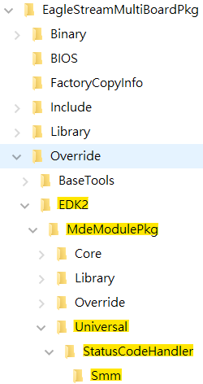
How to Use Override Example
The Override path use the New Codebase Directory Structure, so the path appended to $(PROJECT_PKG)/Override needs to use the relative path from WORKSPACE.
!disable MdeModulePkg/Universal/StatusCodeHandler/Smm/StatusCodeHandlerSmm.inf
MdeModulePkg/Universal/StatusCodeHandler/Smm/StatusCodeHandlerSmm.inf {
<SOURCE_OVERRIDE_PATH>
$(PROJECT_PKG)/Override/EDK2/MdeModulePkg/Universal/StatusCodeHandler/Smm
}
Support Multiple SOURCE_OVERRIDE_PATH
The bottom of the override path has higher priority then upper in DSC <SOURCE_OVERRIDE_PATH> section.
_{<SOURCE_OVERRIDE_PATH>}
OVERRIDE_PATH1 (Lowest priority)
_{OVERRIDE_PATH2}
...
OVERRIDE_PATHN (Highest priority)

Slide 25
FSP

Slide 26

FSP (1/3)
The Intel Firmware Support Package provides the program for initializing Intel silicon and it needs to be integrated into a firmware environment to work.
Generate
Integrate
FSP.bin
BIOS
Intel FSP
source code

Slide 27
FSP (2/3)
The Intel® FSP binary follows the UEFI Platform Initialization Firmware Volume Specification format.
Split into 3 separate FVs
FSP-T: Temporary RAM initialization phase
Primary purpose of this phase is to initialize the Temporary RAM.
FSP-M: Memory initialization phase
Primary purpose of this phase is to initialize the permanent memory
FSP-S: Silicon initialization phase
Primary purpose of this phase is to complete the silicon initialization
including CPU and IO controller initialization.

Slide 28
FSP (3/3)
FSP Binaries path: Intel\EagleStream\EagleStreamFspBinPkg
EagleStreamFspPkg.dsc and EagleStreamFspPkg.fdf describe the drivers and libraries that will be built and generated in FSP binaries
The PCD value used in the FSP binary file should be consistent with the project build

Slide 29
Compile

Slide 30
Compile
Eagle Stream supports the Native build and the FSP build.
Use the FSP build binary to test and tag BIOS.
The Native build binary will still do some simple tests.

Slide 31
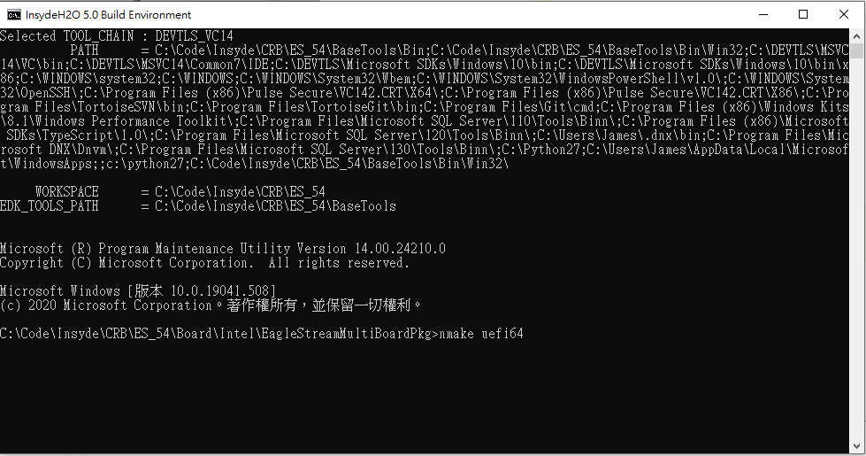
How to Compile Native
Generate the Binary
Double click ProjectBuild.bat
X64: Run “nmake uefi64” or “nmake efidebug”

Slide 32
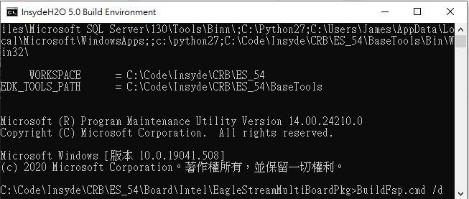

How to Compile FSP
Generate the Binary
Double click ProjectBuild.bat
X64:
Run “BuildFsp.cmd /d” or “BuildFsp.cmd /r” to generate the FSP binary
Run “nmake uefi64fsp” or “nmake efidebugfsp” to generate the full BIOS binary

Slide 33
Thanks!

Slide 34
Backup

Slide 35
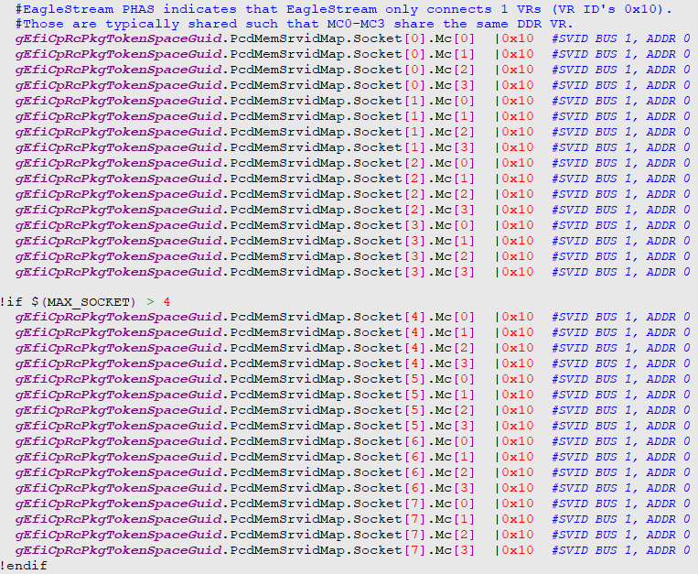
Support structure PCD

